Slide 1
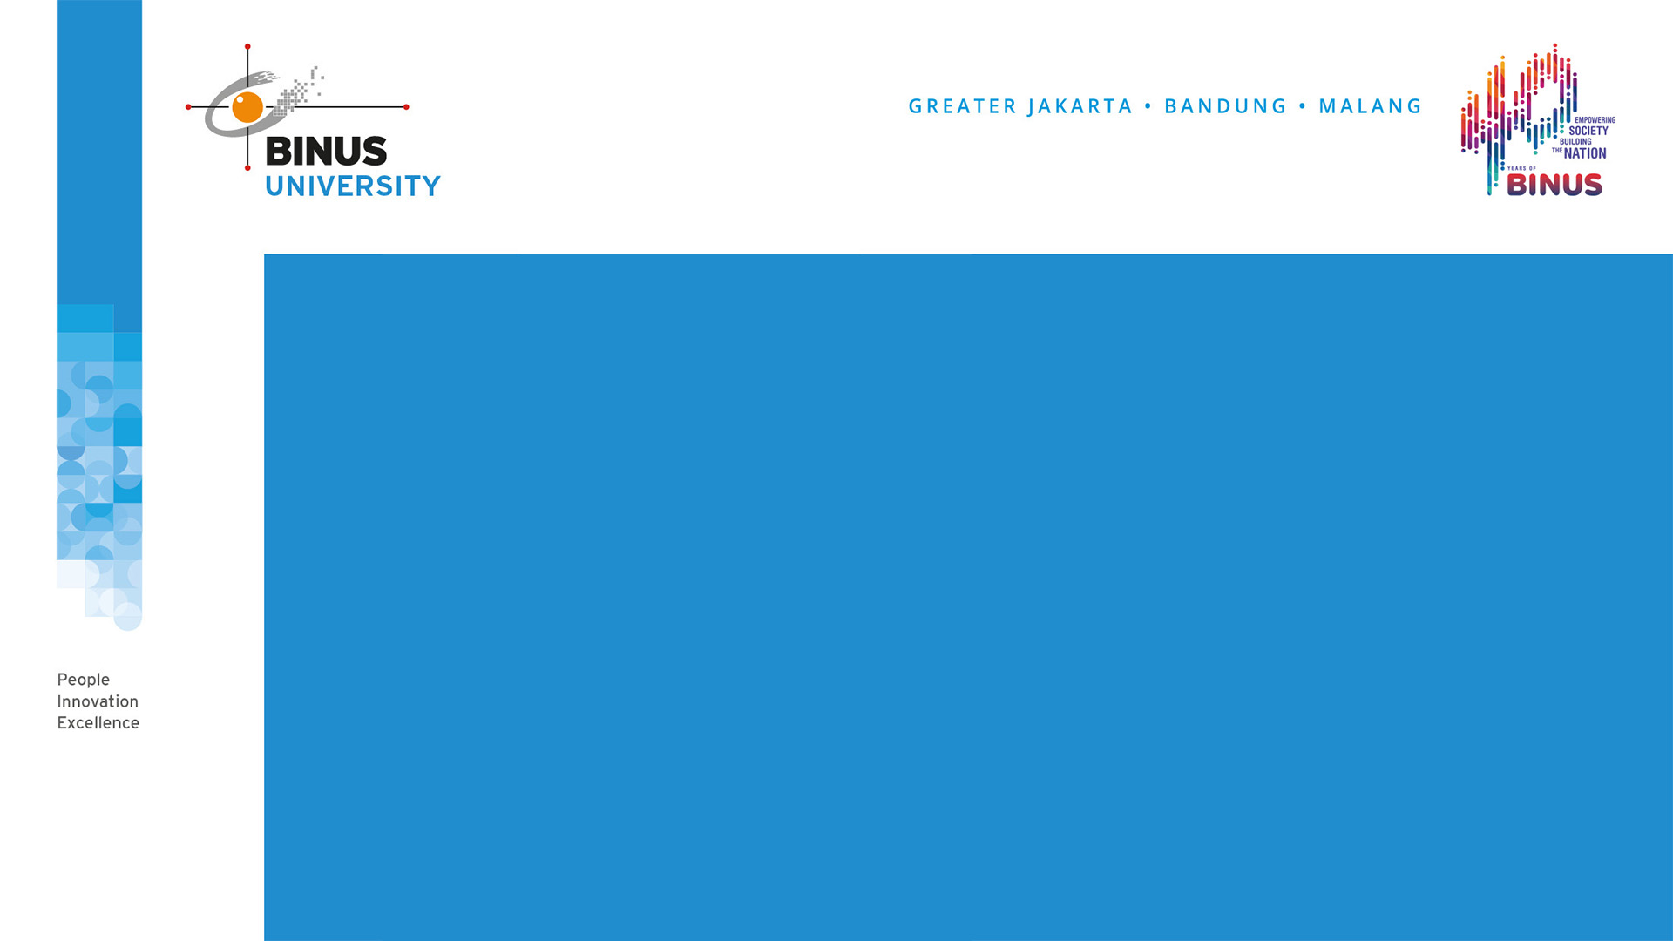
CULTURE INTERACTION
SESSION VII
MK CHARACTER PANCASILA

Slide 2

LEARNING OBJECTIVES
By the end of this session, students are expected:
1. Able to explain the meaning of culture.
2. Able to explain the meaning of culture interaction.
3. Able to analyze the effect of culture interaction.

Slide 3
Definition of Culture
Budaya (Culture) derives from Sansekerta word, “buddhayah”. Buddhayah is the plural word of “buddhi”, that means “reason”.
Culture is perceived as the accumulation of believed values and it becomes people reference or guide on how to behave in daily life.
There are 3 forms of culture: abstract, social system, and physical.

Slide 4
Definition of Culture Interaction and Its Development
When people communicate with each other, an intercultural communication network is formed.
Culture communication is communication that occurs between people who have different cultures (can be racial, ethnic, or socioeconomic, or a combination of these differences).
Humans are always moved to meet other people from various backgrounds: different ethnicities, religions, beliefs, groups, and races. Moreover, the current acceleration of communication technology has sparked people encounter and even nation-to-nation encounters in just a matter of seconds.
We are able to witness events in other countries at the same time. Everything happens because of the development of information technology that is so inherent in human life today.
When the Covid 19 pandemic occurred, humans were still able to communicate and interact with each other thanks to information technology.
The meeting of one cultural group with another creates interaction and reciprocal influence. One culture can adopt positive things from other and vice versa. Even that influence can cause chaos, decline or even negative influence within a certain cultural community.

Slide 5
The Challenge of Culture Interaction
Culture interactions can have both positive and negative impacts.
Negative impact is a challenge that must be addressed immediately.
There are many negative impacts that are a challenge to culture interaction, but there are two things that are very visible today, namely;
Threat of cultural imperialism
Changes in values ​​and behavior

Slide 6
Conclusion
Interactions that occur between community groups will results in cultural interaction. Culture interactions can have both positive or negative impacts depending on how we react to it. The negative impact of culture interaction can appear in form of cultural imperialism and shifts in values ​​that shape behavior that is not in accordance with nation character. This must be anticipated wisely by every level of society without exception.

Slide 7
Discussion
What is culture interaction? And how do you as a student, respond to the various values ​​and foreign views that come with the development of information technology?

Slide 8


